Slide 1


Slide 2
Let’s talk about… SSL / TLS and HTTP / HTTPS !!!

Slide 3
Tech Stuff that’ll come
up today:
Web servers
HTTP / HTTPS
Security
SSL/ TLS
SSL Certifications

Slide 4

What is SSL / TLS?
SSL (Secured Sockets Layer) is a web protocol developed by Netscape in the 90s for enhancing web security.
TLS (Transport Layer Security) was developed by the Internet Engineering Task Force (IETF) as an improvement on SSL.
NOTE: it is common for peeps to use “SSL” to refer interchangeably to both SSL and TLS.

Slide 5
The History
SSL
TLS
TLS was introduced in 1999 as a new version of SSL and was based on SSL 3.0.
As of 21 March 2018, TLS 1.3 is an Internet Draft proposed to Internet Standard. (It is based on the earlier TLS 1.2 specification. )
SSL was originally developed by Netscape in 1995 with SSL 2.0
(SSL1.0 was never released to the public.)
SSL 2.0 was replaced by SSL 3.0 in 1996 after a number of vulnerabilities were found. (Note: Versions 2.0 and 3.0 are sometimes written as SSLv2 and SSLv3.)

Slide 6
What is an… SSL Certificate?
SSL Certificates are small data files that digitally bind a
cryptographic key to an organization’s details.
When installed on a web server, it activates the padlock and the https protocol and allows secure connections from a web server to a browser.
A cryptographic key is a string of bits used by an algorithm to transform plain text into cipher text or vice versa.
(i.e. encryption & decryption)
Notes:
https://www.globalsign.com/en/ssl-information-center/what-is-an-ssl-certificate/
A cryptographic key is a string of bits used by an algorithm to transform plain text into cipher text or vice versa. This key remains private and ensures secure communication. ... Many cryptographic systems include pairs of operations, such as encryption and decryption.

Slide 7
* Image credit goes to UpWork: https://bit.ly/2jwFmIl

Slide 8
What does it look like?
Here’s a very simple example. Say you want to encrypt this sentence:
“Protect your data with encryption.”
If you use a 39-bit encryption key, the encrypted sentence would look like this:
“EnCt210a37f599cb5b5c0db6cd47a6da0dc9b728e2f8c10a37f599cb5b5c0db6cd47asQK8W/ikwIb97tVolfr9/Jbq5NU42GJGFEU/N5j9UEuWPCZUyVAsZQisvMxl9h9IwEmS.”
Now you can send that encrypted message to someone, separately share the key…
And they’ll be able to decrypt it and read the original sentence! ☺

Slide 9
What does an… SSL Certificate even do ?
Overall, SSL is used to secure stuff like:
credit card transactions
data transfer
logins
But more recently, it’s becoming the norm when securing browsing of social media sites.
SSL Certificates bind together:
A domain name, server name or hostname.
An organizational identity (i.e. company name) and location.
Notes:
https://www.globalsign.com/en/ssl-information-center/what-is-an-ssl-certificate/
A cryptographic key is a string of bits used by an algorithm to transform plain text into cipher text or vice versa. This key remains private and ensures secure communication. ... Many cryptographic systems include pairs of operations, such as encryption and decryption.

Slide 10

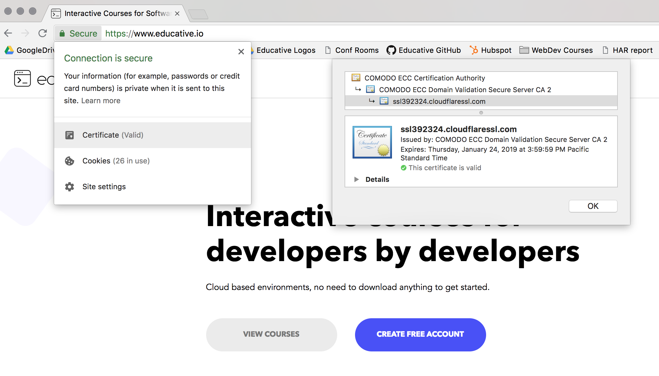
What does a website with an SSL Certificate installed look like?

Slide 11
What other types of SSL certificates are there?
Self-signed certificates:
These aren’t really used for authentication since they aren’t issued by a certificate authority. (But they can be used for encryption.)
These certificates trigger the browser to raise a warning for the user.
Typically used by web dev teams as a cheap solution to setting up SSL-enabled web servers for testing/development.
Notes:
https://medium.com/@User3141592/what-is-ssl-and-how-does-it-work-a5465d19b494

Slide 12
What is HTTP?
HTTP stands for Hypertext Transfer Protocol.
HTTP is used to structure requests & responses over the internet.
HTTP requires data to be transferred from one point to another over the network.
HTTP

Slide 13

What is HTTPS?

Slide 14
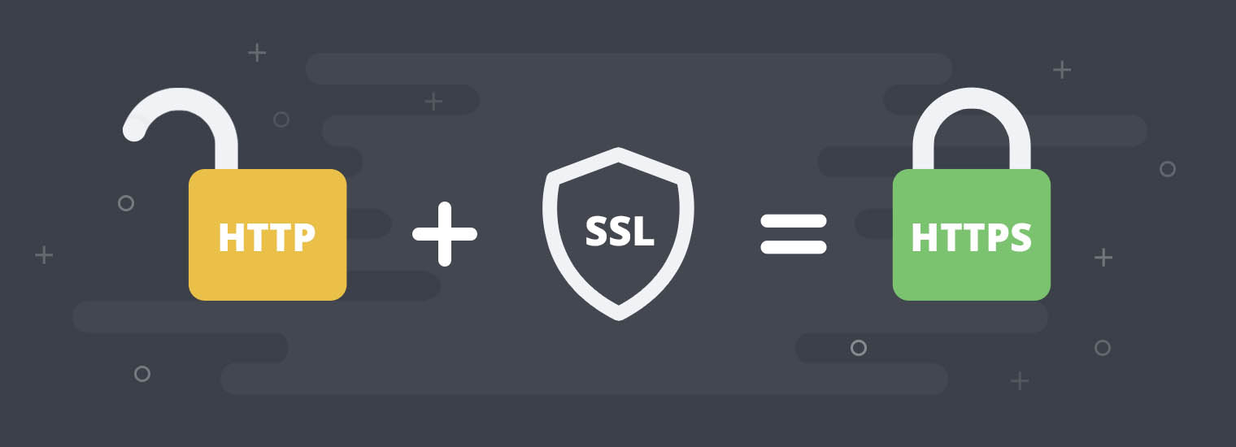

The marriage of SSL & HTTP !

Slide 15
So… then what is HTTPS ?
HTTPS --short for HTTP Secure-- allows you to encrypt data that you send and receive.
HTTPS is important to use when passing sensitive or personal information to & from websites.
It is up to the businesses maintaining the servers to set it up.
In order to support HTTPS, the business must apply for an SSL certificate.
HTTPS
Notes:
Since your HTTP request can be read by anyone, it might not be a good idea to deliver information such as your credit card or password using this protocol.

Slide 16
Congratulations !
Now you too can brag & nerd out with other techies about SSL / TLS and HTTPS stuff!

